Slide 1
SQL FOR INTERVIEWS
February 21, 2017
Columbia Data Science Society

Slide 2
Agenda
01
Introduction
04
General Tips
02
Setup
05
Interview Questions
03
Useful commands
06
Q&A

Slide 3
Introduction
Background
Structured Query Language (SQL) has been around for decades and is the foundation for working with databases.
There are several different types (T-SQL, PL/SQL, PostgreSQL) depending on the database that you’re working with, but most are very similar.
For this workshop
We’ve chosen to work with a Postgres database because has lots of nifty features but is still free
The next slide provides some setup information for Postgres, its GUI interface Postico, and the example database that we’ll be working with

Slide 4
Setup
Instructions
https://eggerapps.at/postico/docs/v1.1.1/
Postgres
http://postgresapp.com/
Postico (Mac-specific)
https://eggerapps.at/postico/
Chinook Database
https://raw.githubusercontent.com/xivSolutions/ChinookDb_Pg_Modified/master/chinook_pg_serial_pk_proper_naming.sql
Just paste the above script into Postico and execute

Slide 5
Concepts
Tables
Databases store data in tables, where each row is a sample and each column is a feature
The tables, their columns, and the data types need to be defined in advance
All tables should have a primary key column, or a unique identifier for every row

Slide 6
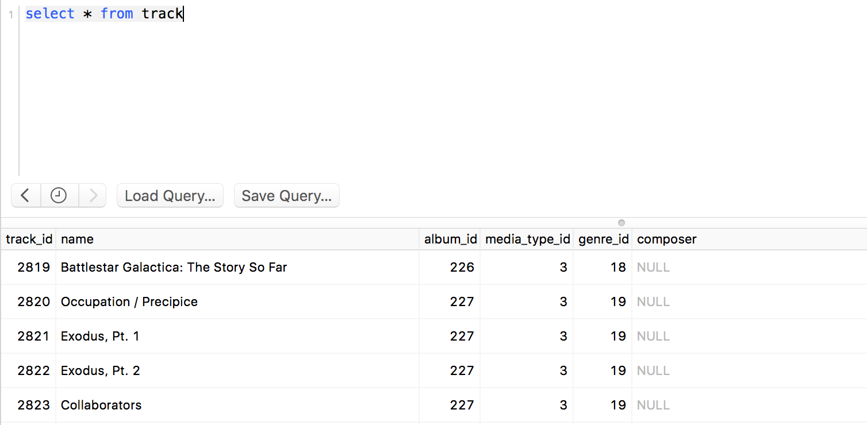
Examples
Selecting Data
Say you want to know everything in the ”Track” table
Use * to grab all the columns from the table

Slide 7
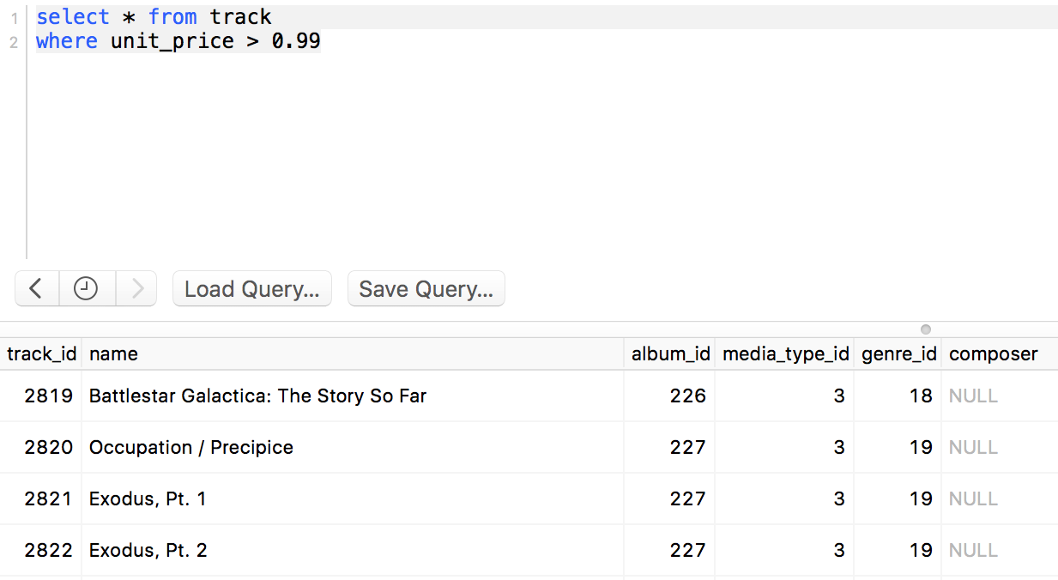
Examples
Selecting Data
Now suppose you want only the tracks with a price > 0.99.
Use the “where” clause

Slide 8
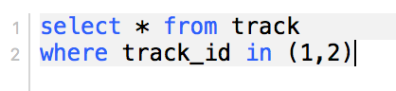
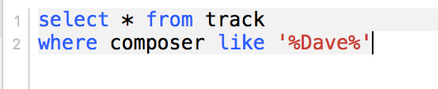
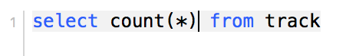
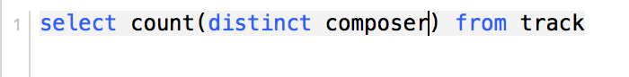
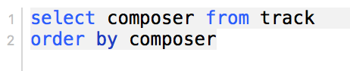
Examples
Selecting Data
There are many options for filtering using where clauses
Use “in” to select from among a list
Use “like” to search for parts of strings
Use “count” for the number of rows rather than the actual results
Or use “count distinct” for the number of unique entries
Use ”order by” to sort the results

Slide 9
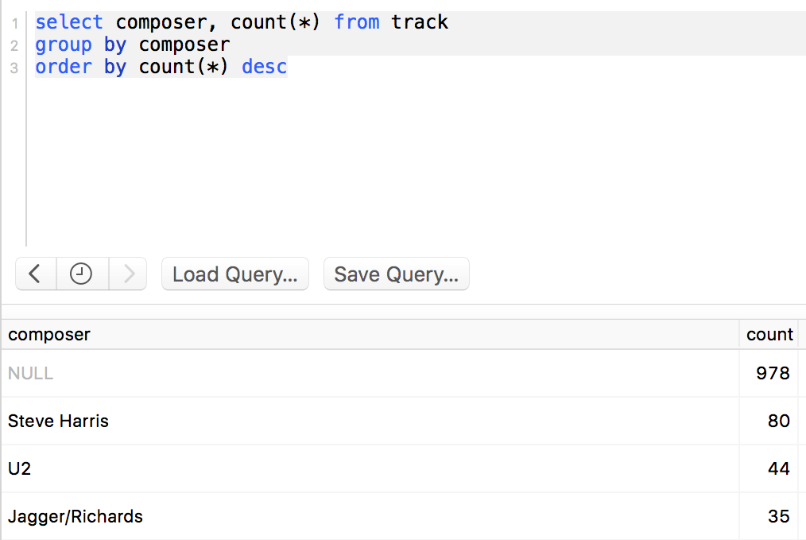
Examples
Aggregating
Let’s say that instead of a count of the distinct composers, you also want to know how many songs each composer has
Use a “group by” clause to aggregate results on your chosen field

Slide 10
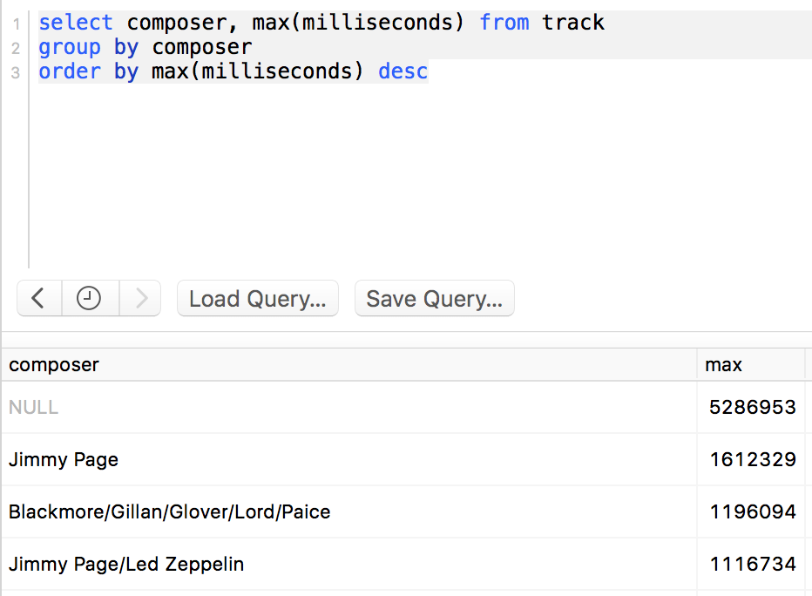
Examples
Aggregating
You can also use a number of other aggregating functions similarly– avg, max, min, etc.

Slide 11
Examples
Joins!
Joins are used to combine tables
This is where primary keys become important– they are generally used to link two tables

Slide 12
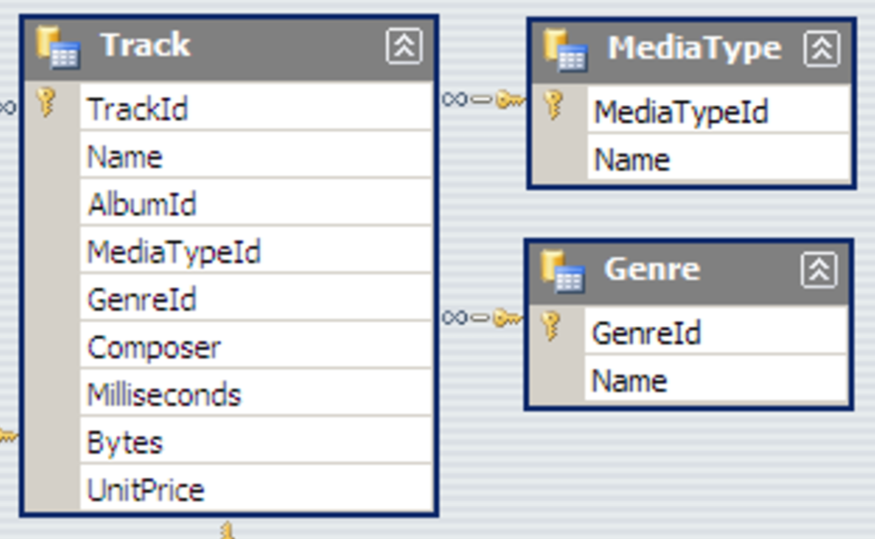
Examples
Joins!
Let’s say you want to know how many tracks there are per genre
The Track table only has genreid, not genre, so we’ll need to join to the Genre table

Slide 13
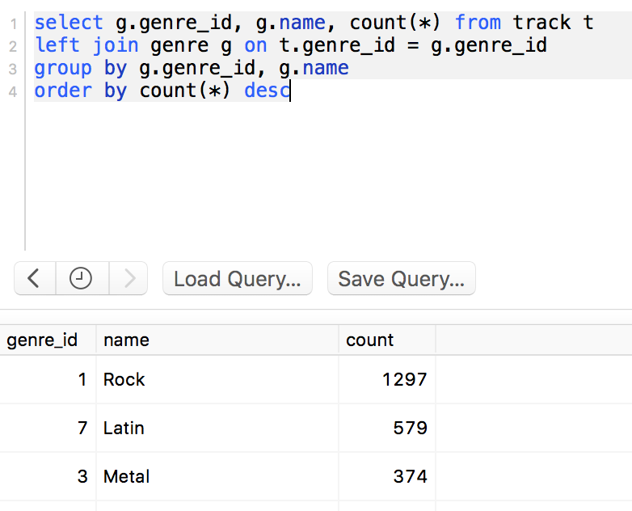
Examples
Joins!

Slide 14
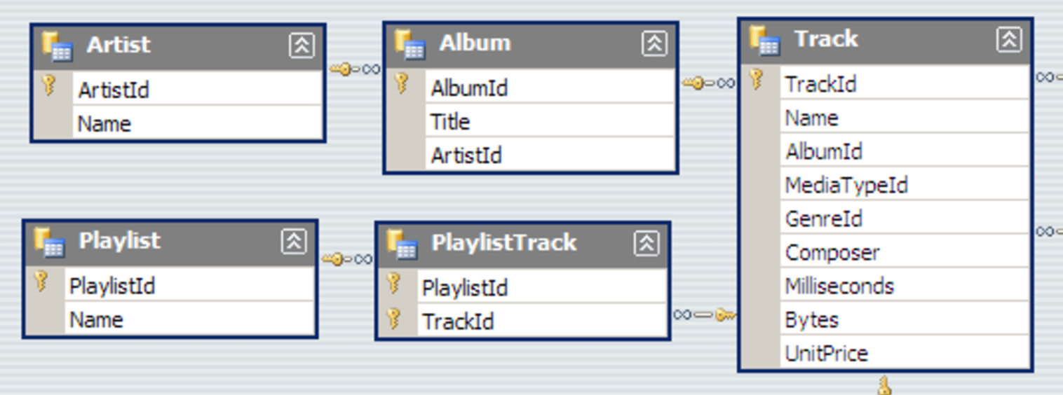
Examples
Nested Queries
Now let’s say you want the number of tracks per artist. Artist is two tables away from track, but because we have keys linking all the tables, we can write a subquery

Slide 15
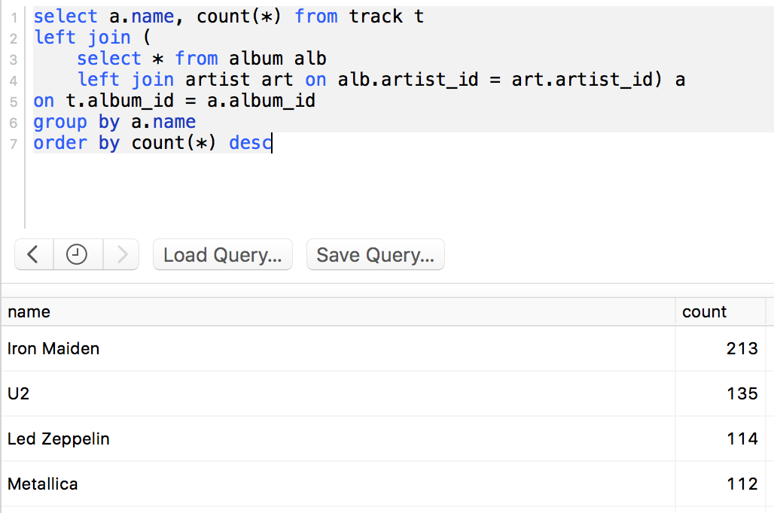
Examples
Nested Queries
Just write a query, then treat it the same way you would treat a table

Slide 16
General Tips
Deleting Data
There are 3 different ways to delete data, with very different results:
Delete: Removes rows that meet a given where clause
Truncate: Delete all rows in a table
Drop: Remove a table entirely
Optimization
Getting the right data is pretty easy, but getting it quickly can be a problem
Only query data you need
Filter, then aggregate/join
If you want even more performance improvements, learn about indexing

Slide 17
CASE EXAMPLE
February 21, 2017
Columbia Data Science Society

Slide 18
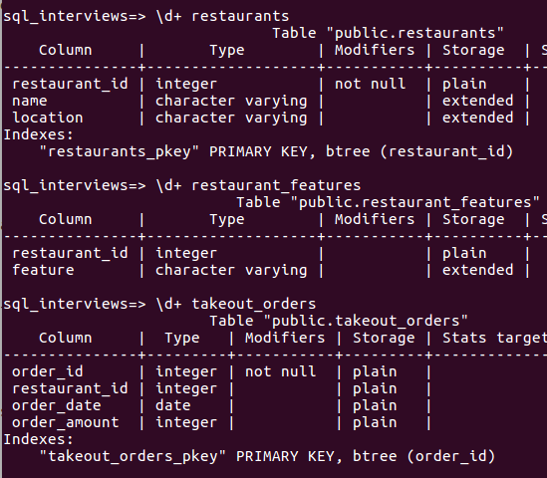
Hungry for Data Science
Given the following table schema:
What is the month-over-month trend in takeout sales from restaurants that are both:
1) Good for groups
and do not
2) Take reservations ???

Slide 19
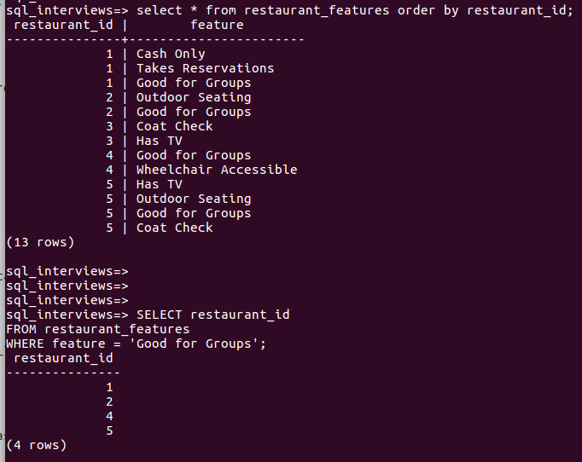
Step 1:
Key Idea:
Identify the relevant subset of restaurants

Slide 20
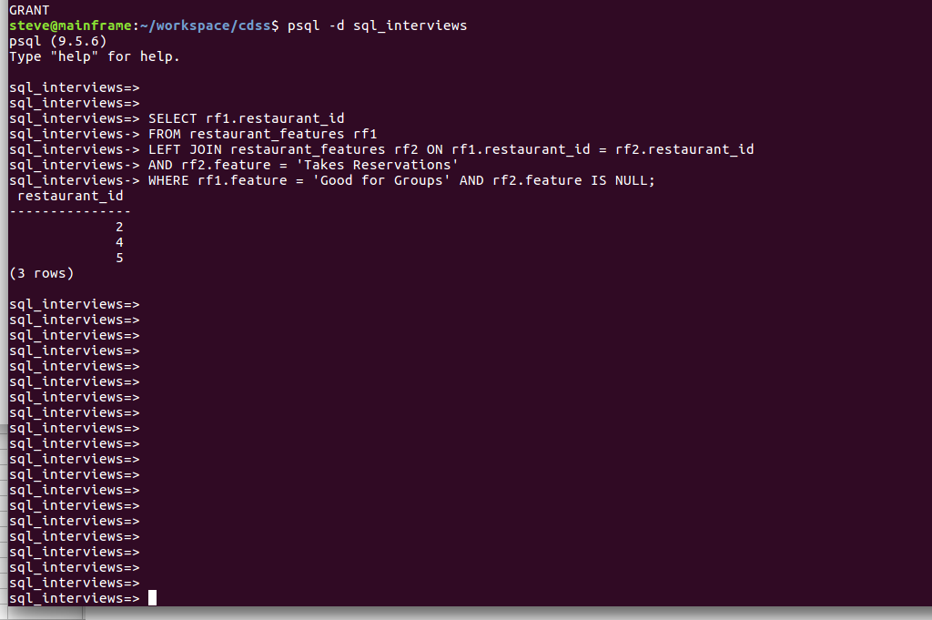
Step 1, cont.
Key Idea:
Self-join and only take rows that are NULL for the value you want to exclude
restaurant_id | rf1.feature | rf2.feature
1 | Good for Groups | Takes Reservations
2 | Good for Groups | NULL
4 | Good for Groups | NULL
5 | Good for Groups | NULL

Slide 21
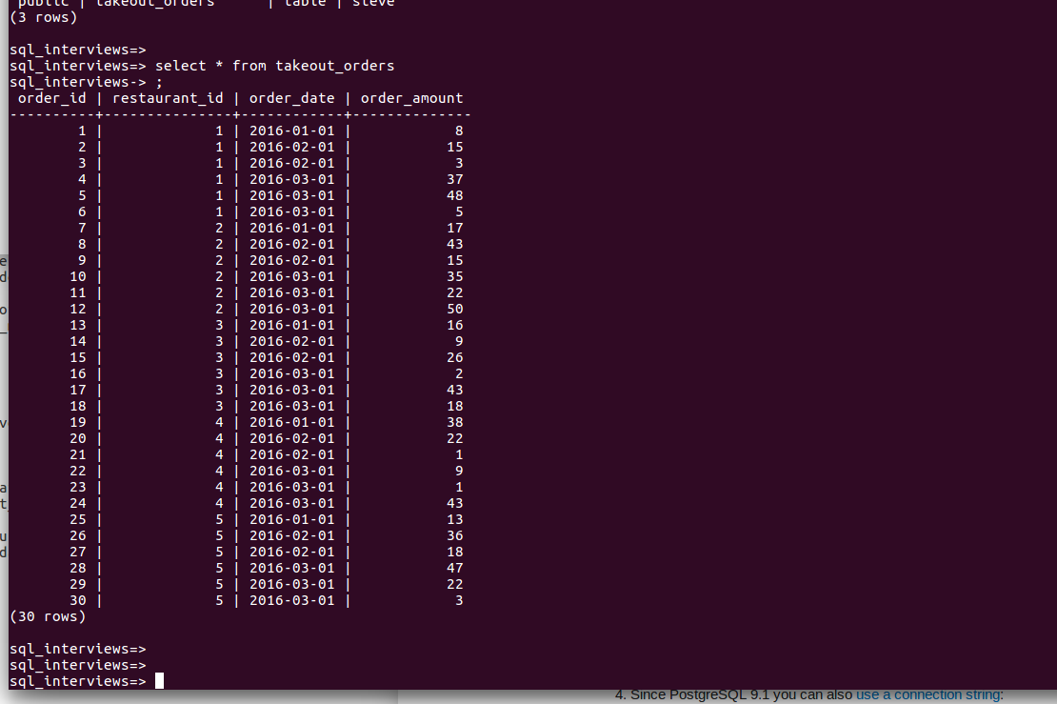
Step 2
Key Idea:
Explore the data, keeping in mind that we want to aggregate takeout sales by month

Slide 22
Step 2, cont.
PostgreSQL — date_trunc()
Truncate a datetime to a specific precision
ex: date_trunc(‘month’, now())
Use ‘Extract’ in MySQL and ‘strftime’ in SQLite.
SELECT date_trunc('month', order_date) AS order_month, SUM(order_amount) AS current_month_total
FROM takeout_orders GROUP BY date_trunc('month', order_date)

Slide 23
Step 3
Key Idea:
Build the trend
PostgreSQL — lag()
Returns the value at the specified row offset of the current row
SELECT order_month, current_month_total, lag(current_month_total, 1) OVER (order by order_month) AS last_month_total
FROM step_2

Slide 24
Putting it all together
Step 1
WITH restaurant_subset AS (
SELECT rf1.restaurant_id FROM restaurant_features rf1 LEFT JOIN restaurant_features rf2 ON rf1.restaurant_id = rf2.restaurant_id AND rf2.feature = 'Takes Reservations' WHERE rf1.feature = 'Good for Groups' AND rf2.feature IS NULL
), order_trend AS (
SELECT order_month, current_month_total, lag(current_month_total, 1) OVER (ORDER BY order_month) AS last_month_total FROM (SELECT date_trunc('month', order_date) AS order_month, SUM(order_amount) AS current_month_total FROM takeout_orders t JOIN restaurant_subset r ON r.restaurant_id = t.restaurant_id GROUP BY date_trunc('month', order_date)) AS monthly_orders
) SELECT order_month, current_month_total, last_month_total, (current_month_total - last_month_total) / last_month_total::DOUBLE PRECISION AS perc_change FROM order_trend ORDER BY order_month;
Step 3
Step 2

Slide 25
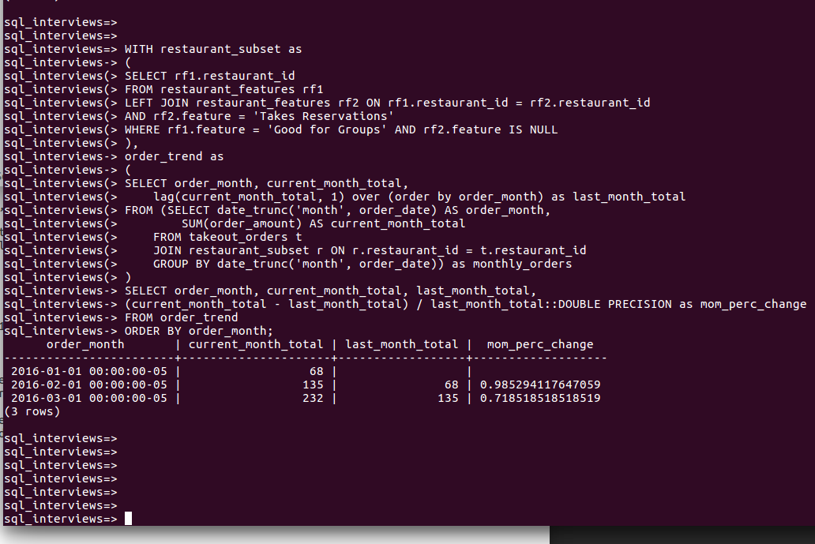
Tada!

